Slide 1
Computer Graphics : output primitives
.

Slide 2
UNIT I: Output Primitives
T1 – pp. 103–123, 137–145, 147–150, 164–171
Points and Lines
Line Drawing Algorithms
Mid–Point Circle Algorithm
Ellipse Algorithm
Character Generation
  University Exam Questions
Unit II: Output Primitives

Slide 3
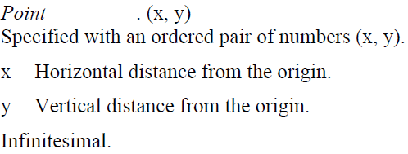
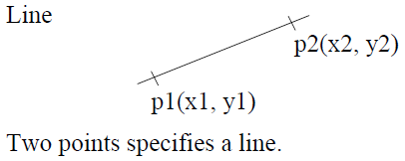
Points and Lines
Unit II: Output Primitives

Slide 4
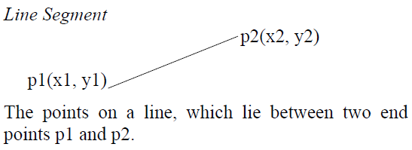
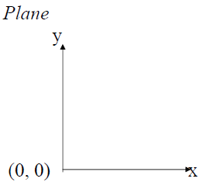
Points and Lines
Unit II: Output Primitives

Slide 5

Pixel
Picture element.
Smallest Addressable Screen element.
Each pixel has a Name or Address.
Computer Graphics images are made by
setting the intensity and colour of the pixels
composing the screen.
Display Screen is a Grid or Array of pixels.
The coordinate (i, j) will give the Col. and Row of a Pixel.
Each pixel will be centred at its Coordinates.
Unit II: Output Primitives

Slide 6
Resolution
Maximum no. of Distinguishable points, which a line may have,
is a Measure of the Resolution of the Display Device.
Greater the no. of Points,
Higher the Resolution.
Dr. DSR Murthy
Unit II: Output Primitives

Slide 7
The Problem Of Scan Conversion
A line segment in a scene is defined by the coordinate positions of the line end-points
y
(7, 5)
(2, 2)
x

Slide 8
The Problem (cont…)
But what happens when we try to draw this on a pixel based display?
How do we choose which pixels to turn on?

Slide 9
Considerations
Considerations to keep in mind:
  The line has to look good
    Avoid jaggies
  It has to be lightening fast!
    How many lines need to be drawn in a typical scene?
    This is going to come back to bite us again and again

Slide 10
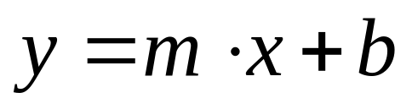
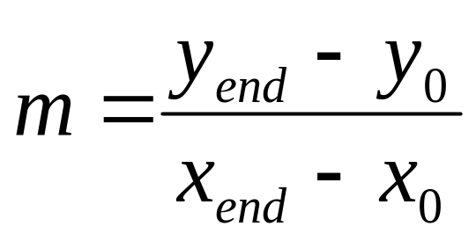
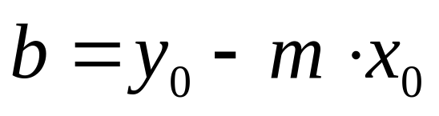
Line Equations
Let’s quickly review the equations involved in drawing lines
Consider 2 end points (X_{0,}Y₀) and (X _{end}, Y _{end})
y
Slope-intercept line equation:
y_{end}
y₀
where:
x₀
x_{end}
x

Slide 11
For any given x intervals dx along a line, we can compute the corresponding y if interval dY from eqn
dy=m dx
Similarly, we can obtain the x interval dx corresponding to a specified dy as
dx = dy/m

Slide 12
A Very Simple Solution (cont…)
Slant Slope Case
Sharp Slope Case
IF M>1
IF M<1
7
7
6
6
5
5
4
4
3
3
2
2
1
1
0
0

Slide 13
Increment of x or y depends on slope
Sharp Slope Case:
If m>1, increment y and find x
dy can be set proposional to a small vertical deflection voltage and the corresponding horizontal deflection voltage set proposional to dx as calculated from eqn.
Slant Slope Case:
If m<1, increment x and find y
dx can be set proposional to a small horizontal deflection voltage and the corresponding vertical deflection voltage set propos ional to dy as calculated from eqn
If m=1, dx=dy and horizontal and vertical deflections voltages are equal.

Slide 14
Lines & Slopes
The slope of a line (m) is defined by its start and end coordinates
The diagram below shows some examples of lines and their slopes
m = ∞
m = -4
m = 4
m = -2
m = 2
m = -1
m = 1
m = -¹/₂
m = ¹/₂
m = -¹/₃
m = ¹/₃
m = 0
m = 0

Slide 15
A Very Simple Solution
We could simply work out the corresponding y coordinate for each unit x coordinate
Let’s consider the following example:
y
(7, 5)
5
2
(2, 2)
2
7
x

Slide 16
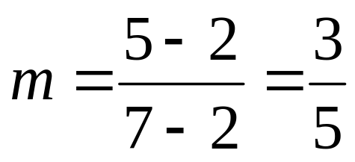
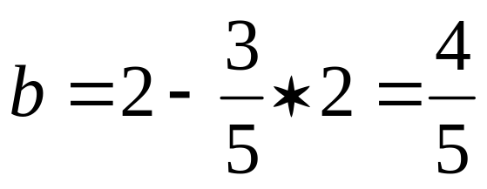
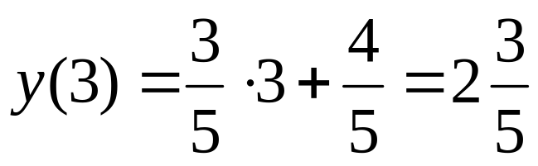
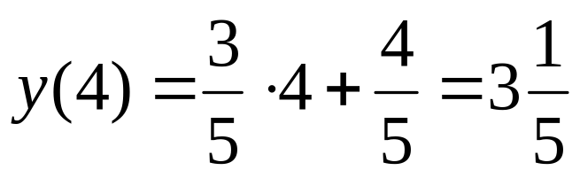
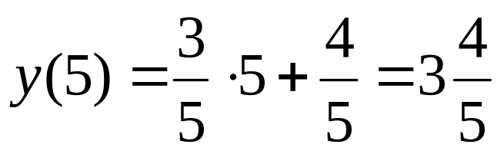
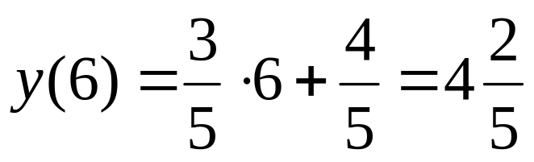
A Very Simple Solution (cont…)
y
(7, 5)
LINE EQUATION : y= mx+b
First work out m and b:
5
2
(2, 2)
2
3
4
5
6
7
x
Now for each x value work out the y value:

Slide 17
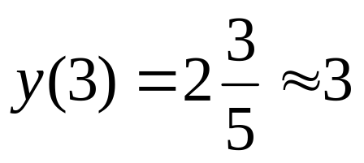
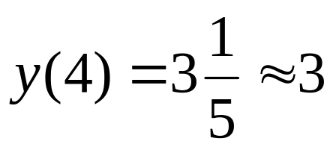
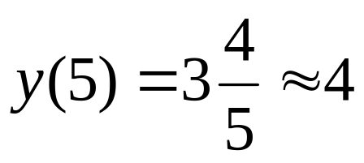
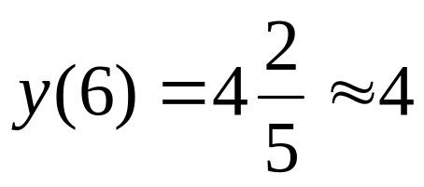
A Very Simple Solution (cont…)
Now just round off the results and turn on these pixels to draw our line
7
6
5
4
3
2
1
0
0
1
2
3
4
5
6
7
8

Slide 18
A Very Simple Solution (cont…)
However, this approach is just way too slow
In particular look out for:
  The equation y = mx + b requires the multiplication of m by x
  Rounding off the resulting y coordinates
We need a faster solution

Slide 19
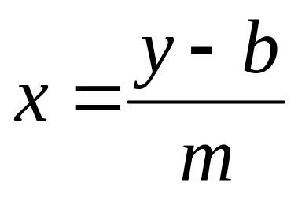
A Quick Note About Slopes
In the previous example we chose to solve the parametric line equation to give us the y coordinate for each unit x coordinate
What if we had done it the other way around?
So this gives us:
where: and
If m>1, increment y and find x
If m≤1, increment x and find y

Slide 20
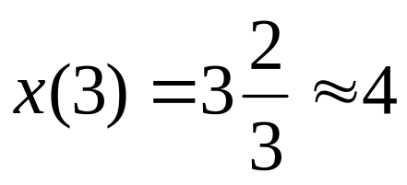
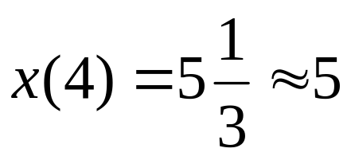
A Quick Note About Slopes (cont…)
Leaving out the details this gives us:
We can see easily that
this line doesn’t look
very good!
We choose which way
to work out the line
pixels based on the
slope of the line
7
6
5
4
3
2
1
0
0
1
2
3
4
5
6
7
8

Slide 21
A Quick Note About Slopes (cont…)
If the slope of a line is between -1 and 1 then we work out the y coordinates for a line based on it’s unit x coordinates
Otherwise we do the opposite – x coordinates are computed based on unit y coordinates
m = ∞
m = -4
m = 4
m = -2
m = 2
m = -1
m = 1
m = -¹/₂
m = ¹/₂
m = -¹/₃
m = ¹/₃
m = 0
m = 0

Slide 22
A Quick Note About Slopes (cont…)
5
4
3
2
1
0
0
1
2
3
4
5
6
7

Slide 23
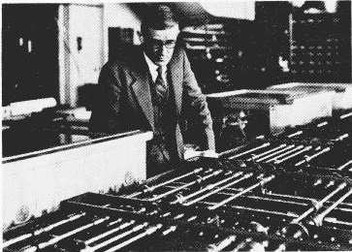
The DDA Algorithm
The digital differential analyzer (DDA) algorithm takes an incremental approach in order to speed up scan conversion
Simply calculate y_{k+1} based on y_{k}
The original differential analyzer was a physical machine developed by Vannevar Bush at MIT in the 1930’s in order to solve ordinary differential equations.

Slide 24
Calculating the Values of ‘x’ and ‘y’
Step 1: For lines whose slope is positive and is less than or equal to 1 (m≤1)
These lines can be sampled at ‘x’ intervals i.e., x = 1 and the corresponding ‘y’ values can be calculated using,
Y_{k+1} = Y_{k}+ m
Where, ‘k’ takes the integer values starting from 1 and its value is successfully incremented, till the last point is reached and the slope ‘m’ can either ‘0’ or’1’.
Step 2: For lines whose slope is positive and is greater than 1 (m>1)
These lines can be sampled at unit ‘y’ intervals i.e., y = 1 and the corresponding ‘x’ values can be determined as,
x_{k+1} = x_{k} / m
Line processing starts from left to right. If the first end point is at right then.
y_{k+1} = y_{k} - m and x_{k+1} = x_{k} / m

Slide 25
DDA algorithm
Step 1: Read the 2 end points (x1,y1), (x2,y2)
Step 2: Horizontal and vertical differences between the end points positions are assigned to parameters dx and dy.
dx=x2-x1
dy=y2-y1
Step 3: The difference with the greater magnitude determines the value of parameter steps
If (abs(dx)> abs(dy)) then
steps = abs(dx) // Slant slope case
Else
steps = abs(dy) // Sharp slope case
Step 4: Starting with pixel positions (x1,y1) and we determine the offset needed at each step to generate the next pixel position along the line path.
X_{increment} = dx/ steps
Y_{increment} = dy/ steps
Step 5: Assign the values of x1, y1 to x,y respectively
x=x1 y=y1
Step 6: Plot the point at (x,y) positions on screen set pixel (round(x),round(y),1). Here 1 is the intensity of pixel i.e, intensity with which picture illuminated.
Step 7: Calculate the values of x and y for next pixel position
X= x+Xincrement
Y= y+ Yincrement
Step 8: Plot the pixel at (x,y) position, set pixel(round(x),round(y),1).
Step 9: repeat the steps 7 and 8 until steps=0.

Slide 26
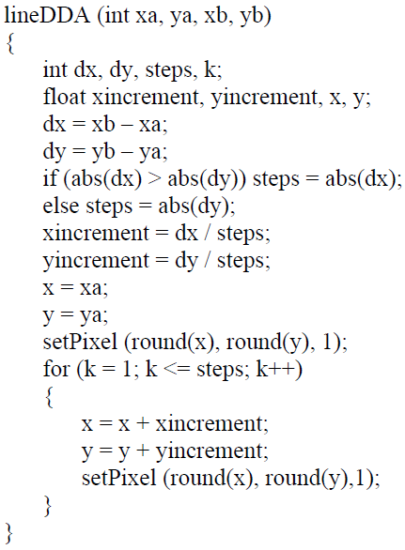
DDA Algorithm

Slide 27
DDA ALGORITHM
#define round(a) (int (a+0.5))
Procedure linDDA( xa, xb, ya, yb : integer);
Var
dx, dy, steps, k : integer;
Xincrement, Yincrement, x,y :real;
Begin
dx = xb-xa; dx, dy calculations
dy= yb-ya;
If abs(dx) > abs(dy) then steps = abs(dx);
Else steps = abs(dy); deciding slant slope or sharp slope
∆x = dx /steps; finding ∆x , ∆y
∆y = dy / steps;
x=xa;
y=ya;
Setpixel (round (x), round (y),1);
For k=1 to steps do
Begin
x= x+ ∆x ;
y= y+ ∆y;
Setpixel ( round(x), round(y),1);
End;
End;
initializing x,y to xa,ya and turning on
that pixel
Turning on all the pixels in b/w
given points (xa,ya) , (xb,yb)

Slide 28
DDA Algorithm.
The following is thus the basic incremental scan-conversion (DDA) algorithm for line drawing
for x from x0 to x1
Compute y=mx+b
Draw_fn(x, round(y))

Slide 29
DDA Example
Suppose we want to draw a line starting at pixel (2,3) and ending at pixel (12,8).
What are the values of the variables x and y at each timestep?
What are the pixels colored, according to the DDA algorithm?
numsteps = 12 – 2 = 10
xinc = 10/10 = 1.0
yinc = 5/10 = 0.5
t | x | y | R(x) | R(y)
0 | 2 | 3 | 2 | 3
1 | 3 | 3.5 | 3 | 4
2 | 4 | 4 | 4 | 4
3 | 5 | 4.5 | 5 | 5
4 | 6 | 5 | 6 | 5
5 | 7 | 5.5 | 7 | 6
6 | 8 | 6 | 8 | 6
7 | 9 | 6.5 | 9 | 7
8 | 10 | 7 | 10 | 7
9 | 11 | 7.5 | 11 | 8
10 | 12 | 8 | 12 | 8

Slide 30
DDA Algorithm Example
Let’s try out the following examples:
y
y
(2, 7)
7
(7, 5)
5
2
2
(2, 2)
(3, 2)
2
7
x
2
3
x

Slide 31
DDA Algorithm Example (cont…)
7
6
5
4
3
2
0
1
2
3
4
5
6
7

Slide 32
Advantages of DDA
It calculates the pixel positions faster than the calculations performed by using the equation y=mx +b.
Multiplication is eliminated as the x and y increments are used to determine the position of the next pixel on a line

Slide 33
Disadvantages of DDA
The rounding and floating point operations are time consuming.
The round-off error which results in each successive addition leads to the drift in pixel position, already calculated

Slide 34
The DDA Algorithm Summary
The DDA algorithm is much faster than our previous attempt
  In particular, there are no longer any multiplications involved
However, there are still two big issues:
  Accumulation of round-off errors can make the pixelated line drift away from what was intended
  The rounding operations and floating point arithmetic involved are time consuming

Slide 35
Conclusion
Drawing lines to pixel based displays is time consuming so we need good ways to do it
The DDA algorithm is pretty good – but we can do better
Next time we’ll like at the Bresenham’s line algorithm and how to draw circles, fill polygons and anti-aliasing

